Slide 1
FarAway Epics
A 2D historic game

Slide 2

Computer Engineering Department A.P. Shah Institute of Technology G.B.Road,Kasarvadavli, Thane(W), Mumbai-400615 UNIVERSITY OF MUMBAI Academic Year 2021-2022

Slide 3





OUR TEAM
Mentor-Prof.Amol Kalugade
Branch-Computer Engineering
Eeshan Joshi
Pranav Chopdekar
Vansh Jain
Soujanya Chavan
Rollno-04
Rollno-27
Rollno-02
Rollno-25
Moodleid:20102012
Div:B
Moodleid:20102009
Div:A
Moodleid:20102156
Div:B
Moodleid:20102005
Div:A

Slide 4
Problem Statements:
Video games are often only considered a source of entertainment and not information.
Video games shape young minds and often, not in a good way.
There are about 400 million people playing video games in India any time.
Historic figures of our nation are often not portrayed properly.
Audio Visual media are not used effectively to convey a story.

Slide 5
Objectives:
Learning game and animation engines like unity and adobe animate in order to make the game quality more desirable and fun to play.
Designing the perfect story which is more understandable and specific knowledge imparting through the use of digital media.
Making the game flow as easy as possible including the obstacles and the controls (specifically character controls without any bugs).

Slide 6
Scope
3-protagonists
Linear Progression
Skill tree
This game will have a new approach of 3 different playable protagonists.
This game will follow a linear path and playstyle.
This game will have a skill tree which will add some difficulty into the game.

Slide 7
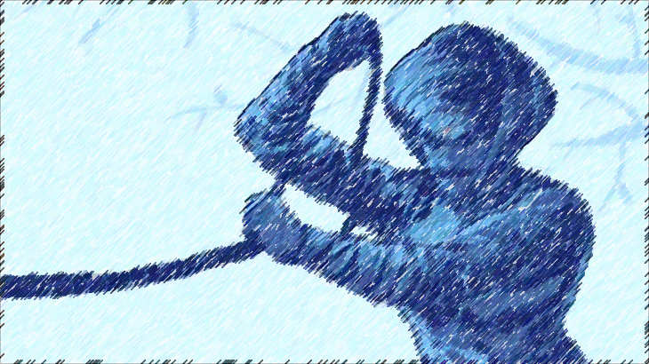
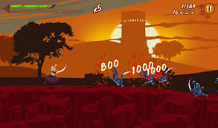
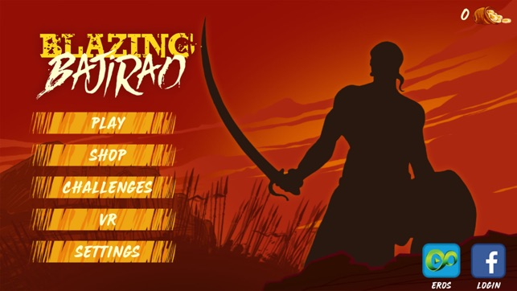
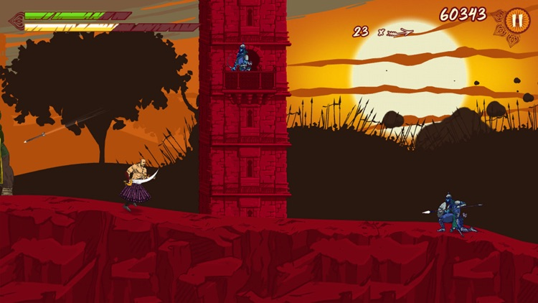
References:
The game name “Blazing Bajirao” by Eros Now.
It is a mobile game made to promote their web series.

Slide 8
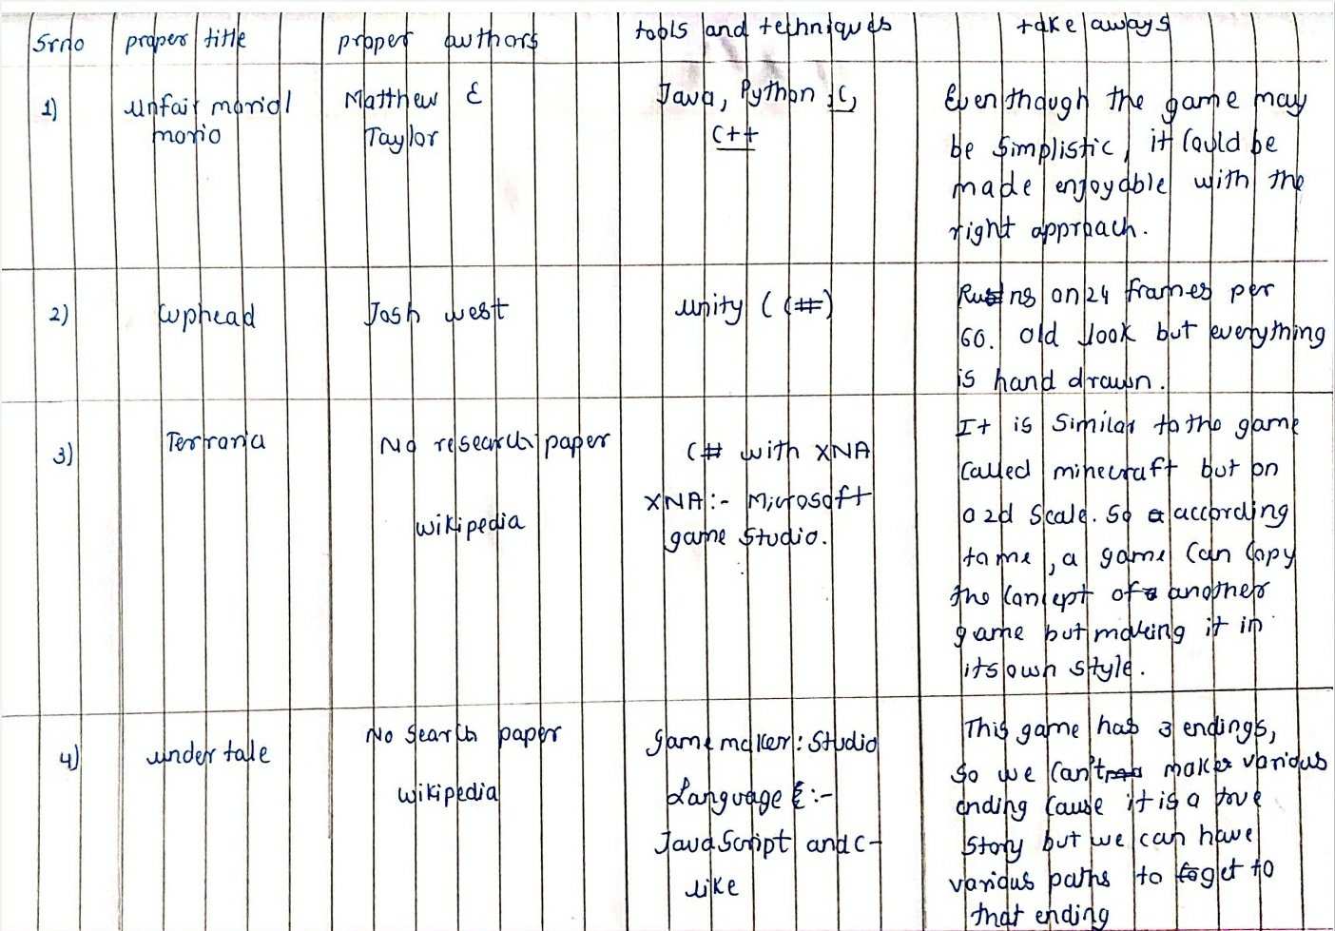
Research done related more 2d games

Slide 9
For learning unity we went through the user manual and the Youtube videos regarding unity tutorials.
Link to the user manual:-Unity - Manual: Unity User Manual 2020.3 (LTS) (unity3d.com)
Link to unity playlist:-https://youtu.be/j48LtUkZRjU

Slide 10

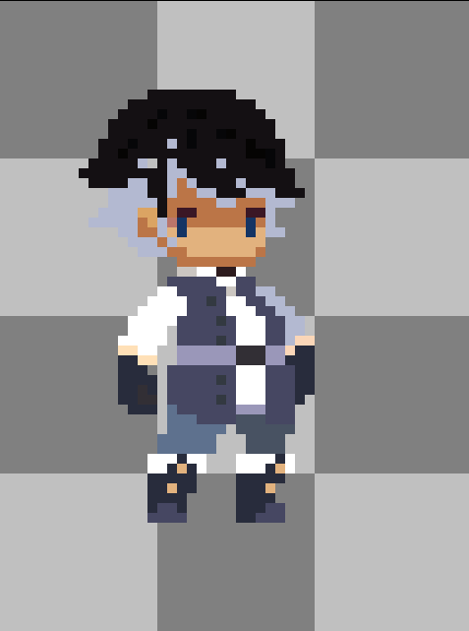
Link for the character tutorial:-https://youtu.be/vXm5VjZA4Ys
Referance Character used for drawing other characters

Slide 11
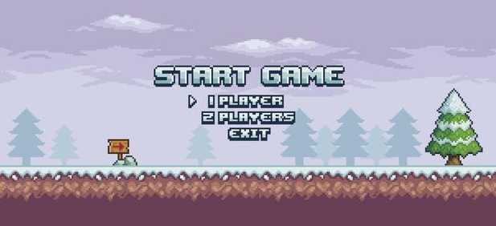
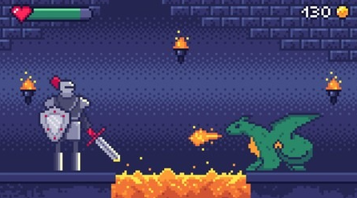
Reference for UI of the game

